Slide 1
A Thomas Ware
Capstone Project.
Solutions Calculator Club product development

Slide 2
Lesson 1
ELTR-160 Project Management
“Plan For Success”

Slide 3
Solutions Calculator Club Product Development
Project Charter
Scope:
Tasked with developing an educational tool to show how a Computational System and Subsystems processes inputs and outputs.
Resources:
A research grant for a development budget of $20,000.
The project research phase time frame of 4 months and an implementation phase time frame was 4 months.
Stakeholders:
Solutions calculator Club are the investors
Thomas Ware is the project developer
Trevor Murray consultant
UFV potential client
Ben Eater 8-bit computer kit Supplier
Risks and assessments:
Scope of the project for a single person, supply chain issues like chip shortages or obsolete components and shipping time if replacements are required. Limitations of the ALU and memory size of registers.
Gantt Chart

Slide 4
Lesson Plans
CMNS-125
Communication For Professionals
APA Style ……………………………………………………………………….
Research Report:
The History of Calculators and the Technological Innovations ……………
Email Correspondence:
Club Proposal to Student Union ………………………………………………
Revision of Club Proposal Email ……………………………………………..
Bad News Email ………………………………………………………………..
Club Presentation ………………………………………………………………

Slide 5
Solutions Calculator Club Product Development
CMNS-125 Research:
History and Innovations of the Calculator

Slide 6

History and Innovations of the Calculator
The Abacus
Binary
Weighed Sum
Register
The first calculating device known was the Abacus. Invented in China around the 2nd century B.C. However, Abacus-like devices are first attested from ancient Mesopotamia around 2700 B.C.

Slide 7
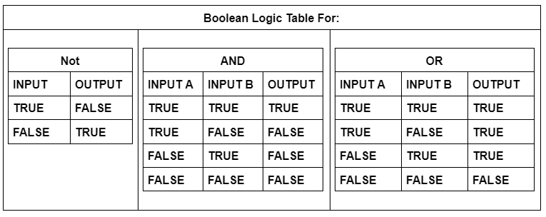
History and Innovations of the Calculator
ELTR-130 Data Logic

Slide 8
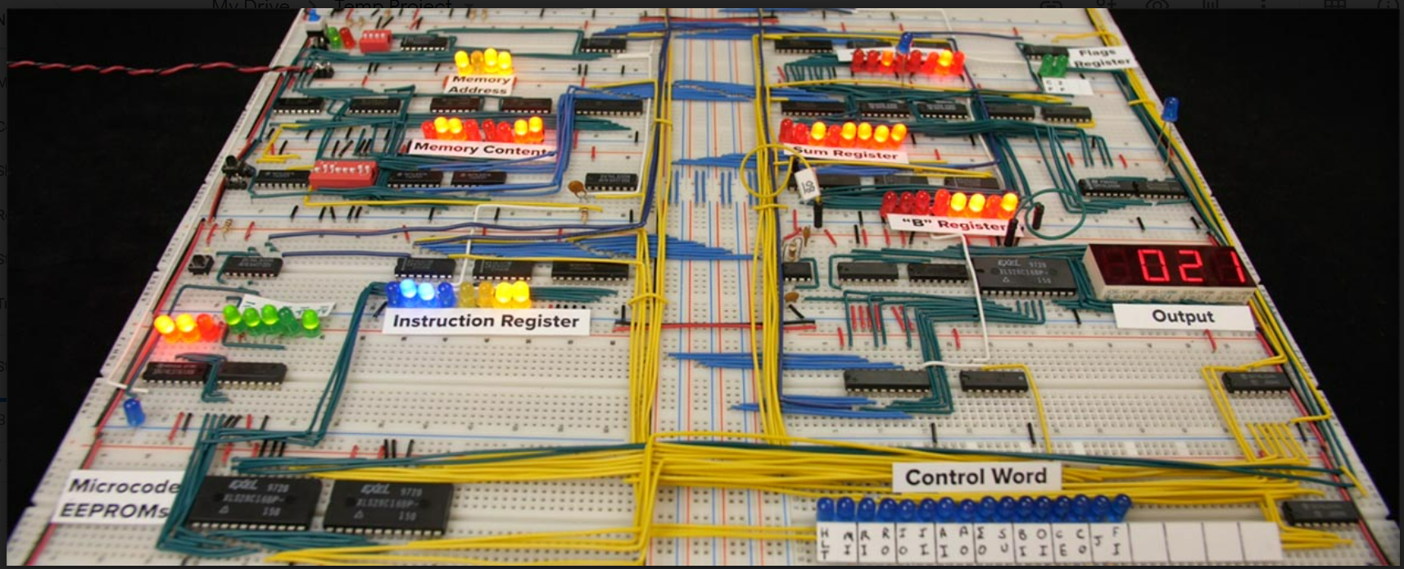
Ben Eater’s 8 Bit Computer
(2016)

Slide 9
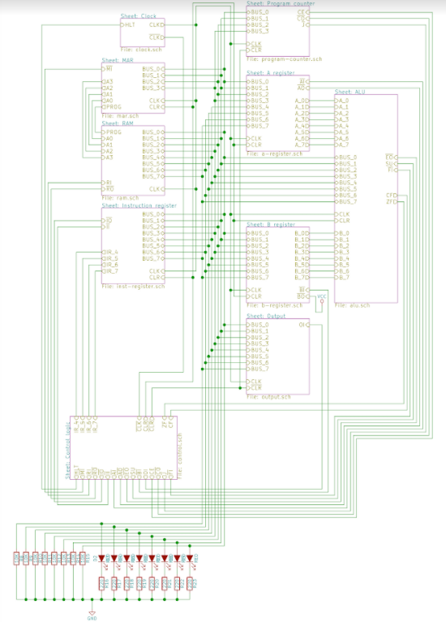
Ben Eater’s 8 Bit Computer
Module 1 The System Clock
Module 2
Registers
A register
B register
Instruction Register
Arithmetic unit (ALU)
Module 3
Memory Address Register (MAR)
Random access memory (RAM)
Program counter
Module 4
CPU control logic
Output Register (Display 7 Segment)
The Bus communication
Flag Register (Carry bit, Zero)
Module 5 AC adapter for development of project and safety.
Master Sheet

Slide 10
Lesson Plans
ELTR-170
Electronic System Integration
Wiring subsystems
Wire Preparation
Troubleshooting
Interconnections of Modules
Notes:
Course Overview
Course topics will include:
Introduction to Digital Home Technology Integration
Basic Integration Methods
Low-Voltage Wiring
High-Voltage Wiring
Audio and Video Systems
Basic Telecommunications Integration
Home Lighting Control
Home Environmental Control

Slide 11
Ben Eater’s 8 Bit Computer
MAR and RAM
Bus
Instruction Register
Clock
Program Counter
Registers A&B and ALU
Output and Control Logic

Slide 12
Lesson Plans
ELTR-110
Manufacturing Processes
Project 1
Using MULTISIM Design a 12v Power Supply

Slide 13
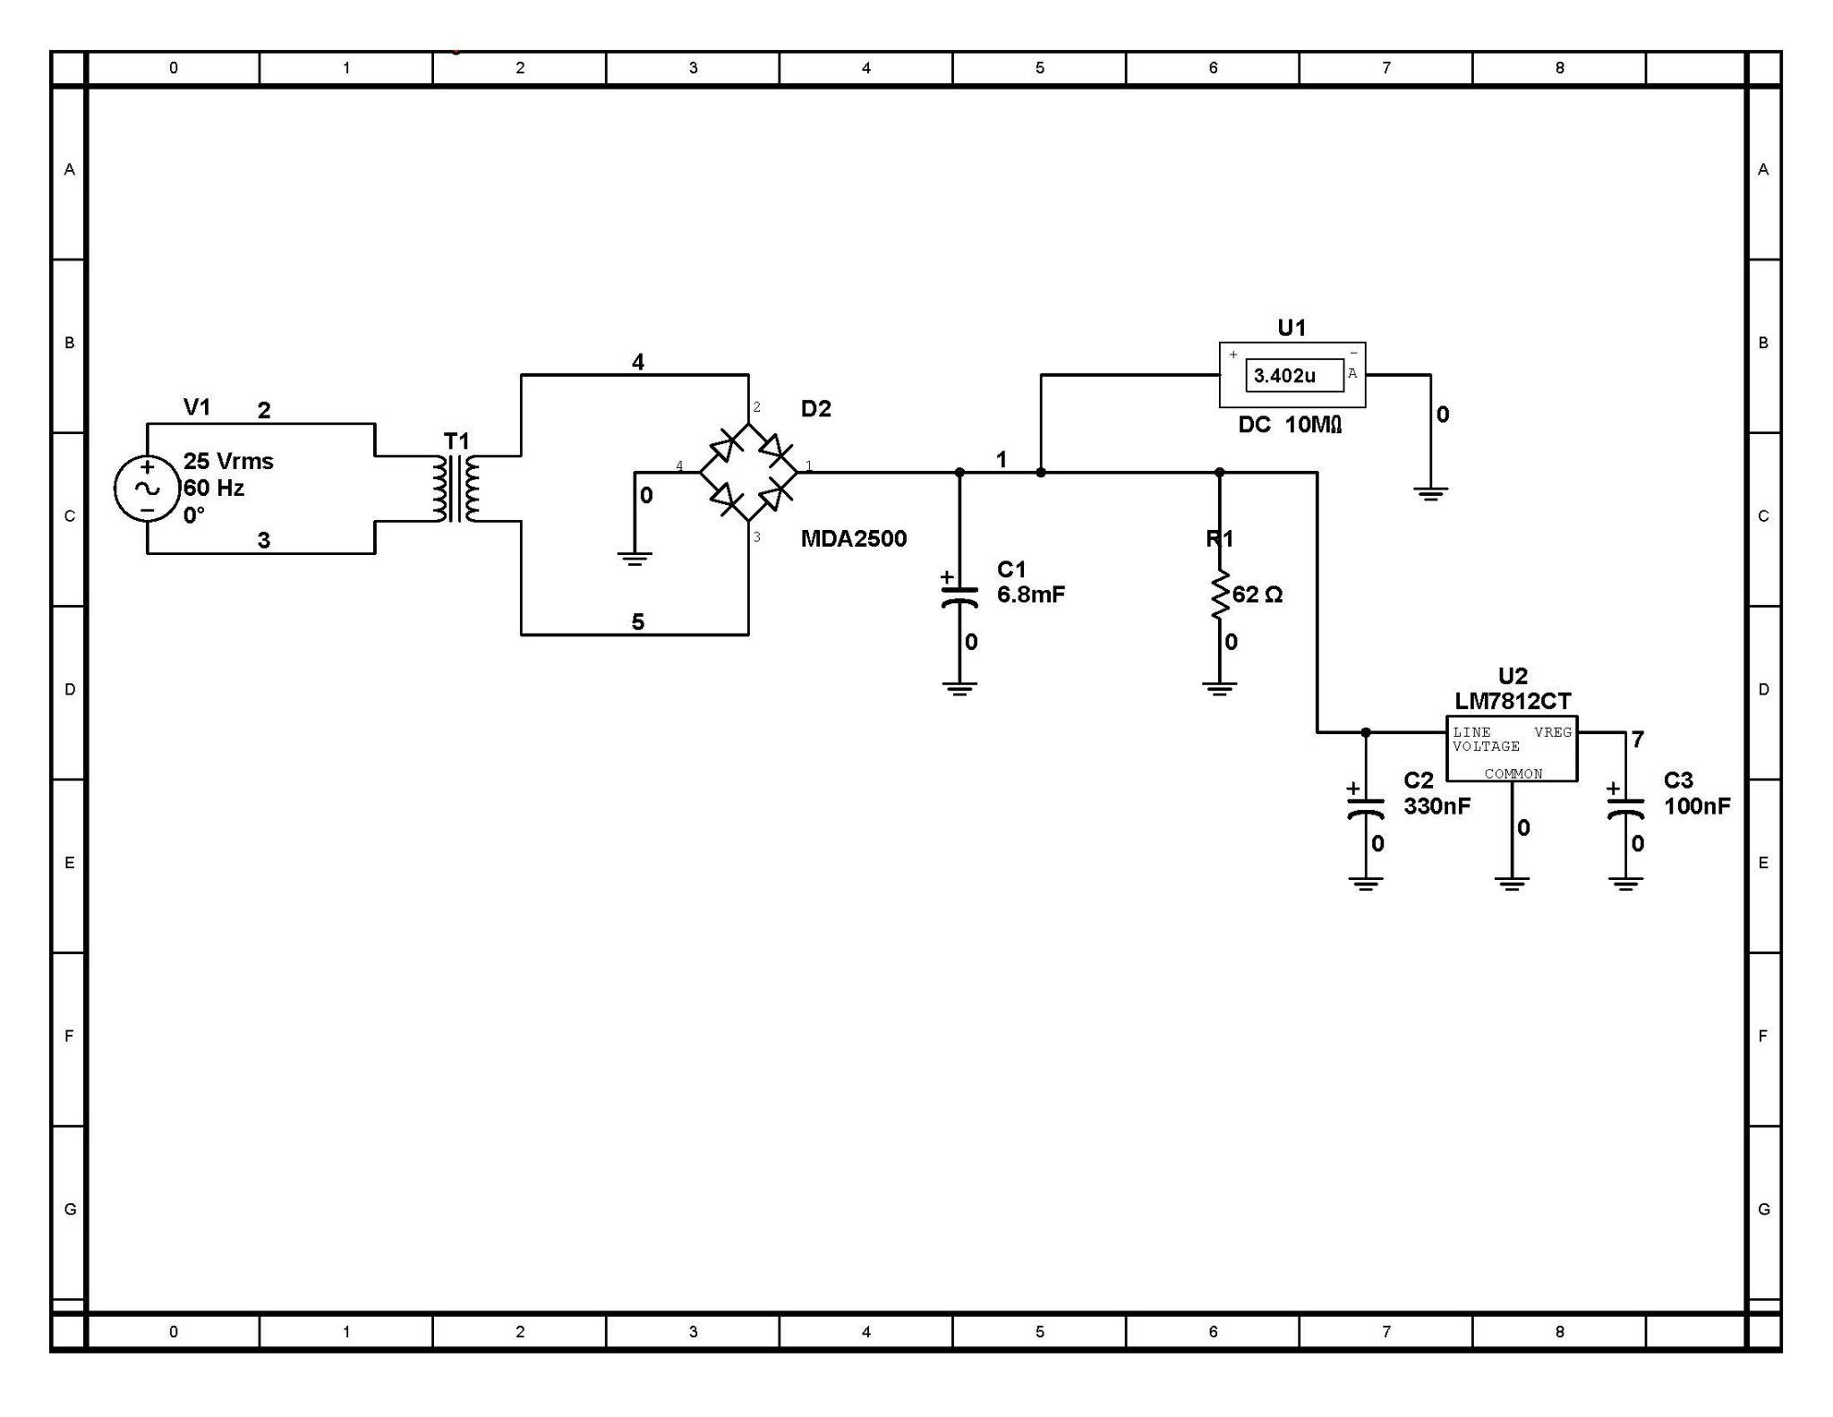
Power Supply Module 5:
Use Schematic to Layout a PCB Design.
PCB EDITING MAYBE REQUIRED LATER.

Slide 14
Lesson Plans
ELTR-110
Manufacturing Processes
Project 2
Building The Clock Module

Slide 15
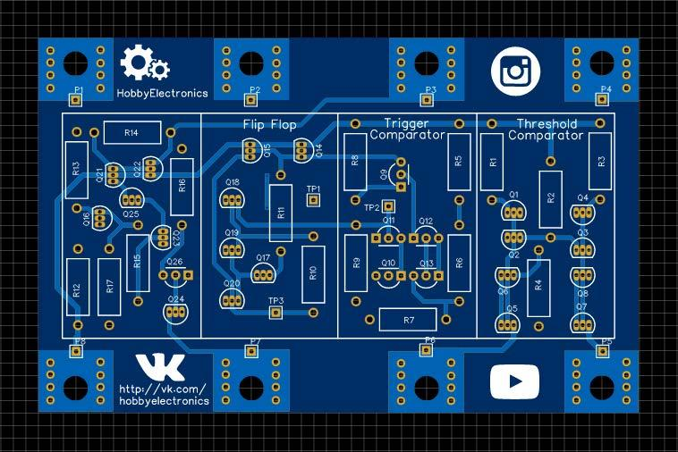
PCB 555 Timer

Slide 16
The Clock Module
Astable
Clock
Mono Stable
Bi Stable
Prototype 2

Slide 17
Lesson Plans
ELTR-100
Electrical Network Analysis
Analysis Project 1 using Project 2 from ELTR-110
Circuit Analysis of 555 Timer
Circuit Schematic Designed with Discrete components
Analysis Project 2 using Project 1 from ELTR-110
Power Supply Circuit
How to safely measure AC Power and the Power Supply Circuit
Notes:
Course Overview
Unit 1 - Basic concepts, electrical quantities, electrical components, Ohm’s Law, Kirchhoff’s Laws, series circuits, parallel circuits, series-parallel circuits. (Ch. 1-6)
Unit 2 - Network theorems, networks analysis techniques, Thevenin’s Theorem, Norton’s Theorem, mesh analysis, maximum power theorem, nodal analysis. (Ch. 7-8)
Unit 3 - Electromagnetism, measuring instruments, basic AC theory, oscilloscopes. (Ch. 9-12)
Unit 4 - Inductance, inductive reactance, RL circuits, transformers. (Ch. 13-16)
Unit 5 - Capacitance, capacitive reactance, RC circuits (Ch. 17-19)
Unit 6 - RLC Circuits, resonance. (Ch. 20-21)

Slide 18
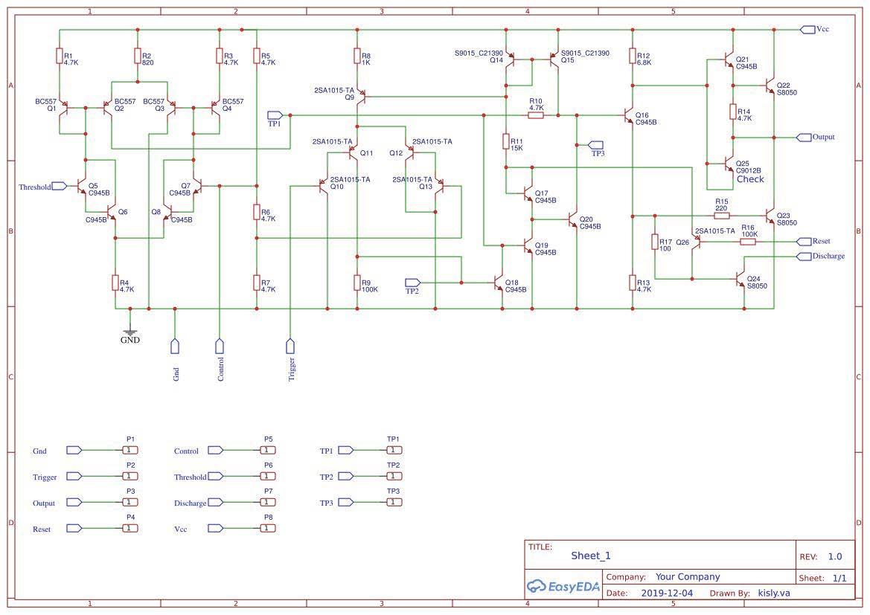
Schematic 555 Timer
For ELTR-110

Slide 19




XSC3
Tektronix
P 1 2 3 4 T G
0
U1
4
+
-
0.000
A
^{V1} 2
2
D2
1
DC 10M
0
T1
25 Vrms
4
1
60 Hz
0°
0
3
3
MDA2500
R1
C1 6.8mF
62 Ω
0
5
XMM1
0
U2 LM7812CT
Power Supply Module 5
Network Analysis
using Test Equipment
LINE VREG VOLTAGE
COMMON
0
C2
C3 100nF
330nF
0
0
0
7

Slide 20
Lesson Plans
ELTR-150
Solid State Semiconductor Devices
Use Analysis Project from ELTR-100
Build a 555 Timer from Discrete components
Revision of ELTR-110 Project 1
Revise Power Supply to work with your Capstone Project for ELTR-190
Notes:
Course Overview
Unit 1 – Semiconductors & Diodes (Ch. 1-3)
Unit 2 – Bipolar Junction Transistors (BJTs) (Ch. 4)
Unit 3 – BJT Amplifiers (Ch. 6-7)
Unit 4 – Field-Effect Transistors (FETs), FET Amplifiers, Frequency Response (Ch. 8-10)
Unit 5 – Thyristors (Ch. 11)
Unit 6 – Operational Amplifiers (Op-Amps), and Op-Amp circuits (Ch. 12-13)
Unit 7 – Active Filters, Oscillators and Voltage Regulators (Ch. 15-17)

Slide 21
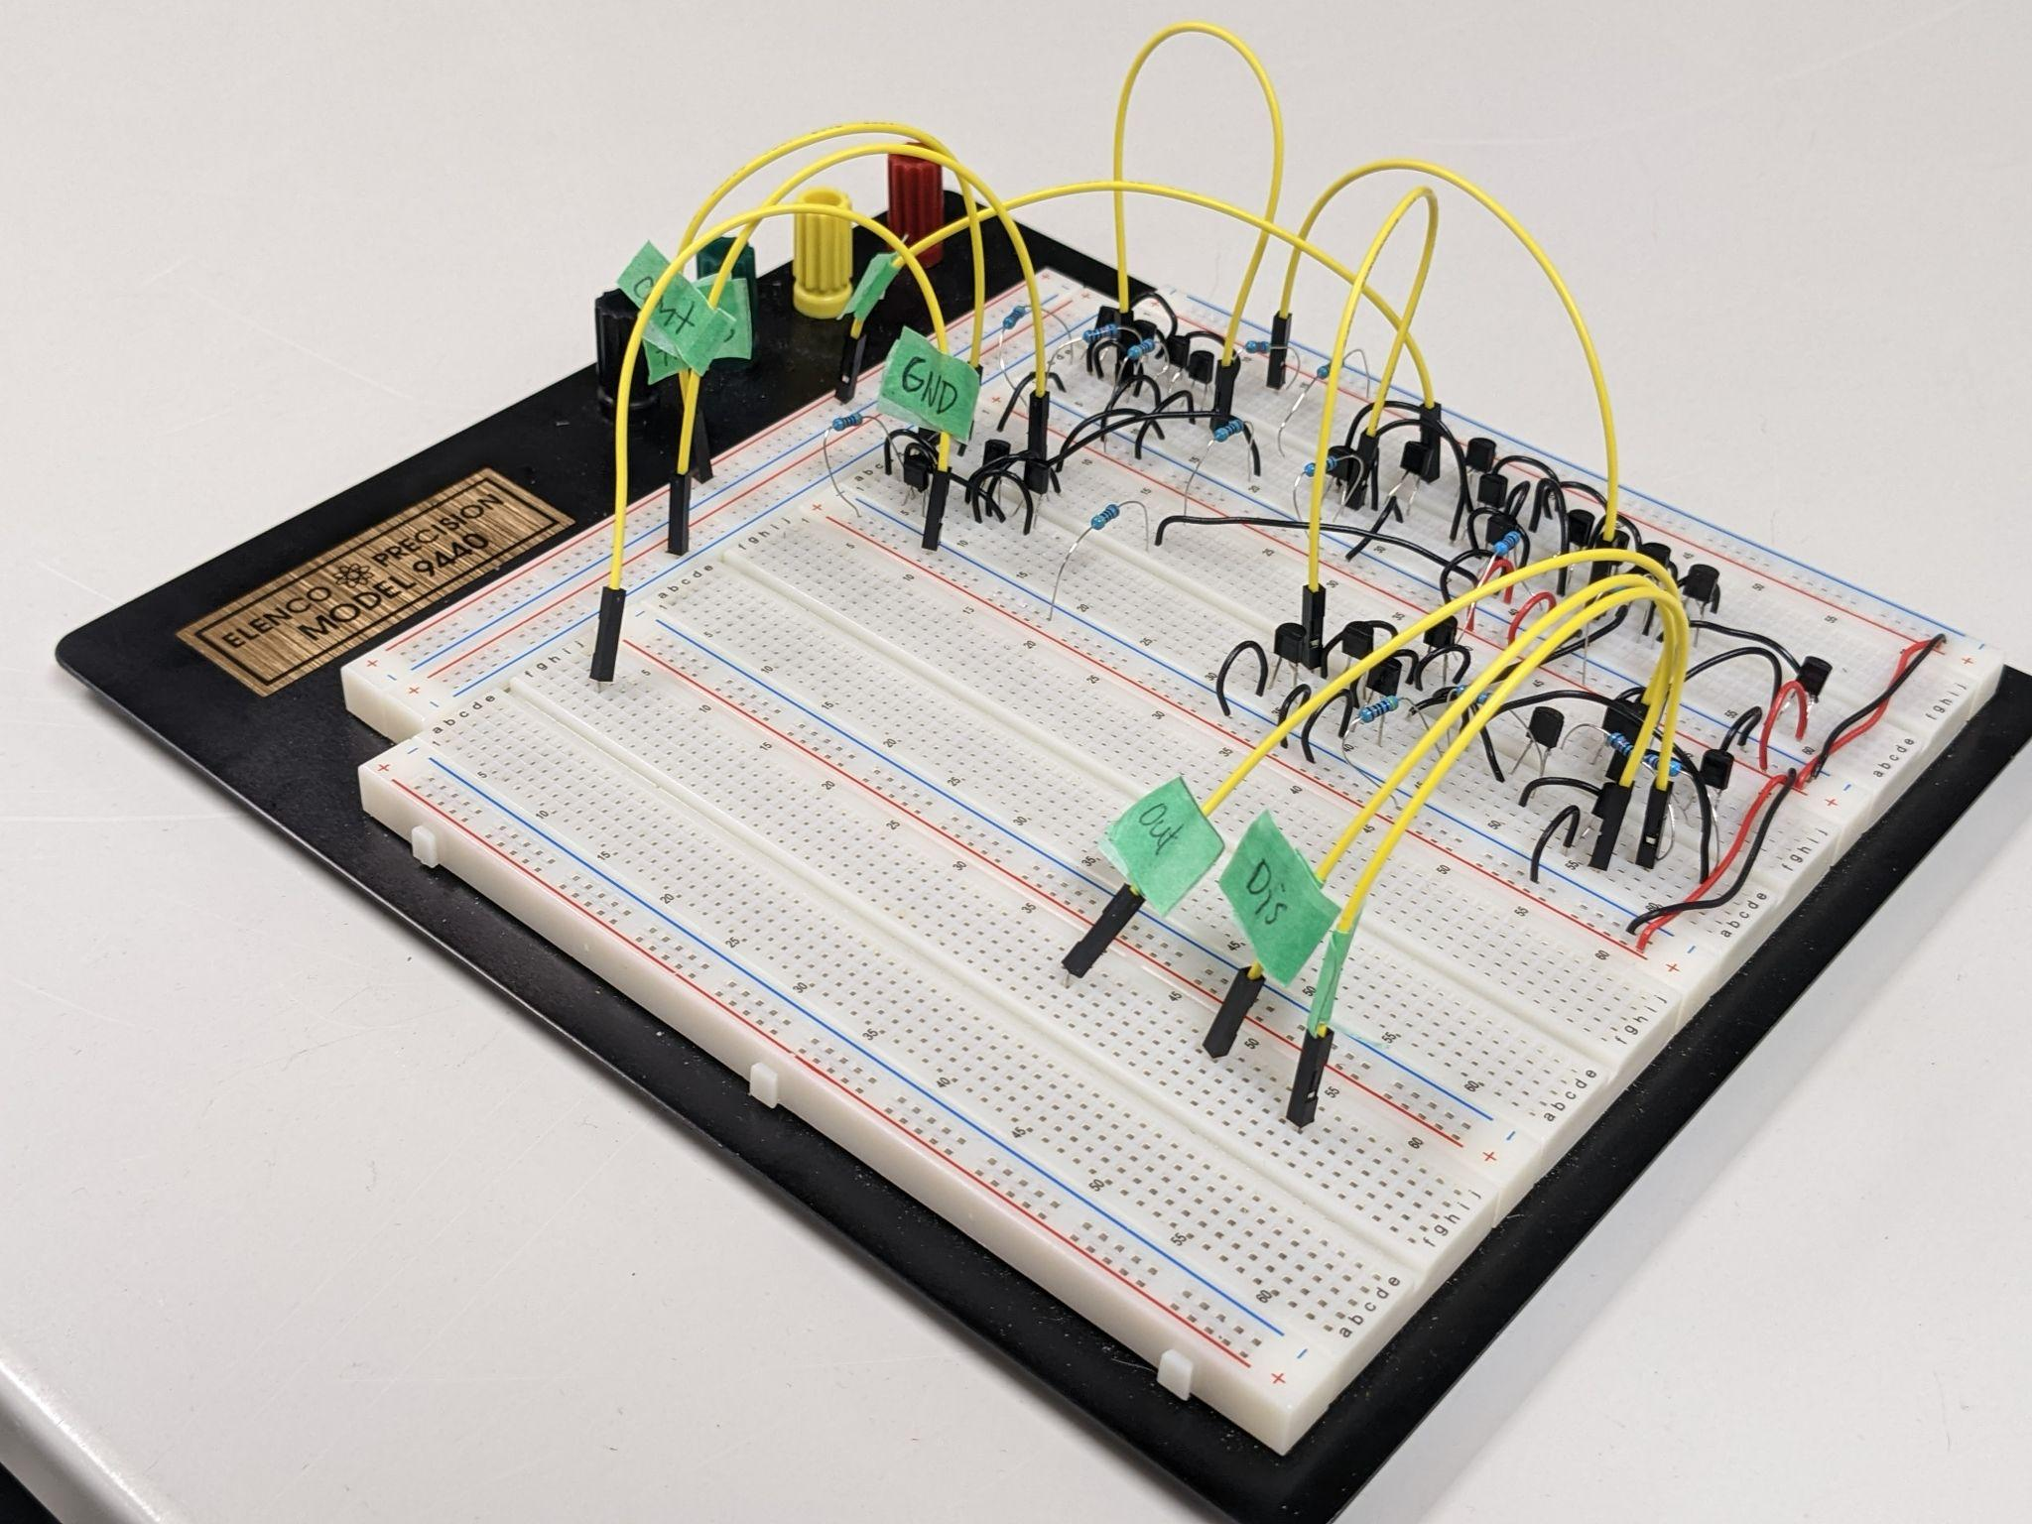
ELTR-150: 555 Timer from Discrete components
Example: Photo of prototype on Breadboard

Slide 22
Lesson Plans
ELTR-130
Digital Logic Systems
Use Analysis Project 1 from ELTR-100
Build AND OR NOT Logic from Discrete components
Use LOGISIM to construct Logical Circuits for:
Comparator, Adders, Latches, Registers, Counters, Encoders, Decoders, Selector/Multiplexers, ALU, 7 Segment Display, Control Logic, and CPU
Notes:
Course Overview
Unit 1 – Foundational concepts and number systems (Ch. 1-2)
Unit 2 – Basic logic functions and logic gates (Ch. 3)
Unit 3 – Boolean Algebra (Ch. 4)
Unit 4 – Combinational logic, functions and analysis (Ch. 5-6)
Unit 5 – Specialized logic ICs: Latches, timers, flip-flops, registers and counters (Ch 7-9)

Slide 23
Ben Eater’s 8 Bit Computer
Register A
ALU
Sum Out
Register B
ADD and Subtraction Operations
Notes:
Register Logisim File: C:\Users\Thomas\Desktop\Logisim\8 bit Register.circ
ALU Logisim File: C:\Users\Thomas\Desktop\Logisim\1_Bit_ALU.circ

Slide 24
Ben Eater’s 8 Bit Computer
ELTR-130 Data logic
How Do Binary Values ADD?
00011100
00001110
28
14
42
00101010

Slide 25
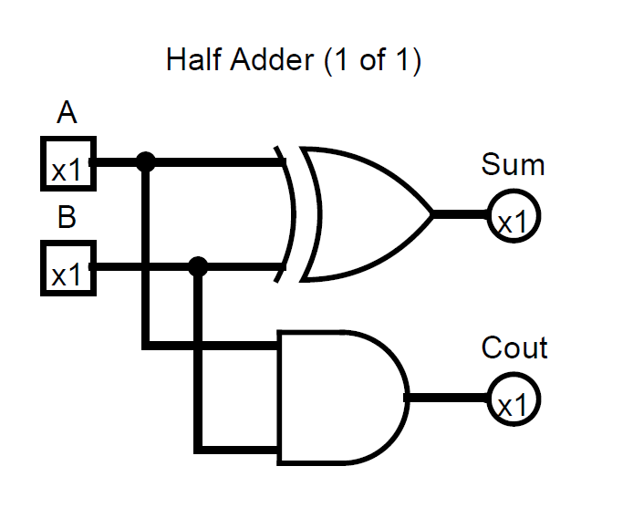
Ben Eater’s 8 Bit Computer

Slide 26
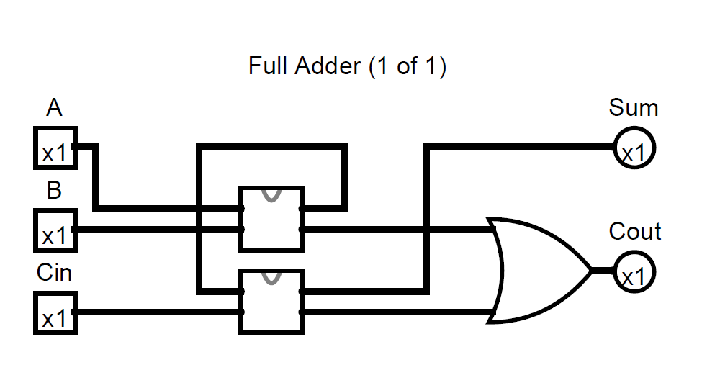
Ben Eater’s 8 Bit Computer

Slide 27
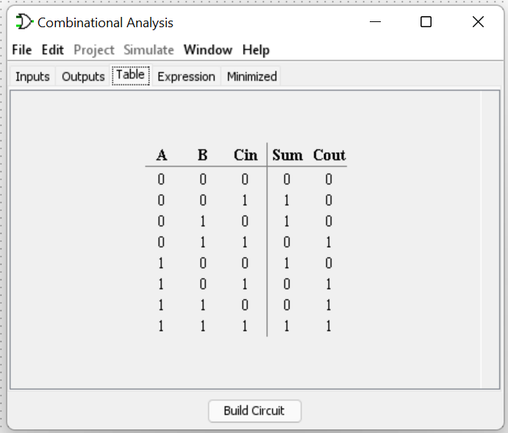
Ben Eater’s 8 Bit Computer

Slide 28
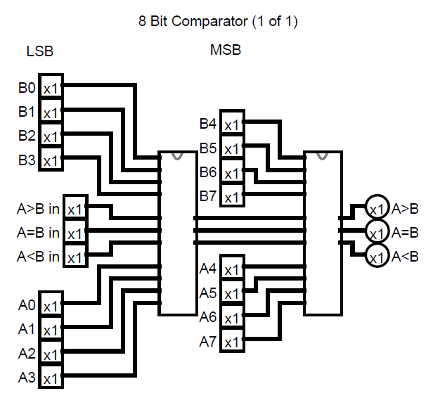
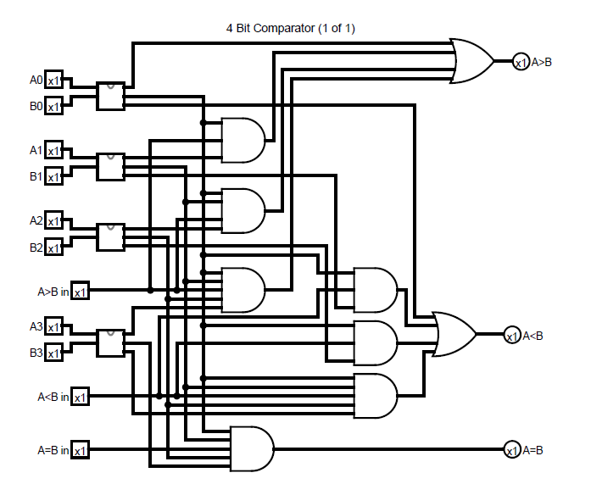
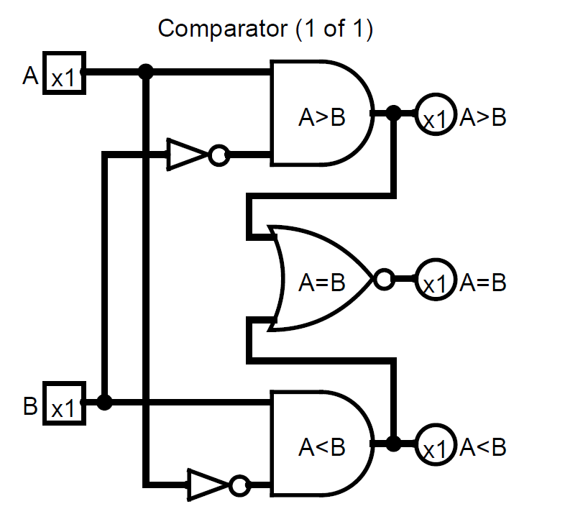
Ben Eater’s 8 Bit Computer

Slide 29
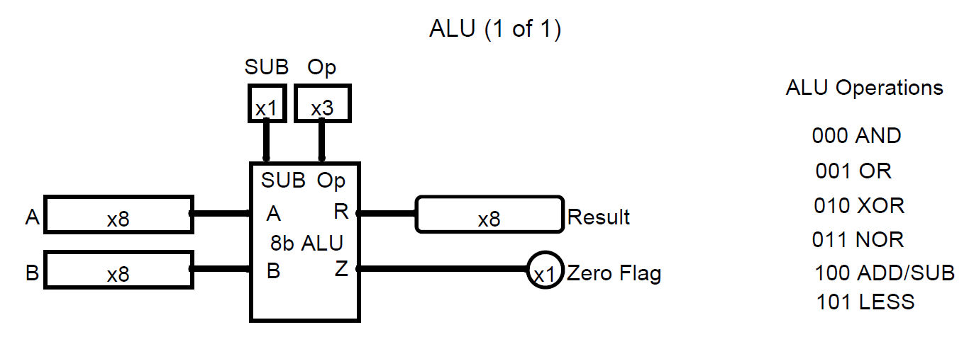
Ben Eater’s 8 Bit Computer
Logisim ALU
RUN Here.

Slide 30
Ben Eater’s 8 Bit Computer
ADD | A and B are summed
ADD with CARRY | A and B and a Carry-In bit are all summed
SUBTRACT | B is subtracted from A (or vice versa)
SUBTRACT with BORROW | B is subtracted from A (or vice versa) with borrow (carry-in)
NEGATE | A is subtracted from zero, flipping its sign (from - to +, or + to -)
INCREMENT | Add 1 to A
DECREMENT | Subtract 1 from A
PASS THROUGH | All bits of A are passed through unmodified
8 Operations Circuits:

Slide 31
Ben Eater’s 8 Bit Computer
Write to memory
Read from memory
Registers are groups of latches, which holds a single number, and the number of bits in a register is called its width.
RAM or Random Access Memory
Persistent Memory

Slide 32
Ben Eater’s 8 Bit Computer
Program Counter
MAR
Clock
RAM
Instruction
Program Counter
Memory, Addresses Instructions
Run Mode And Program Mode
Notes:
This clock Breadboard Circuit was made on TinkerCad

Slide 33
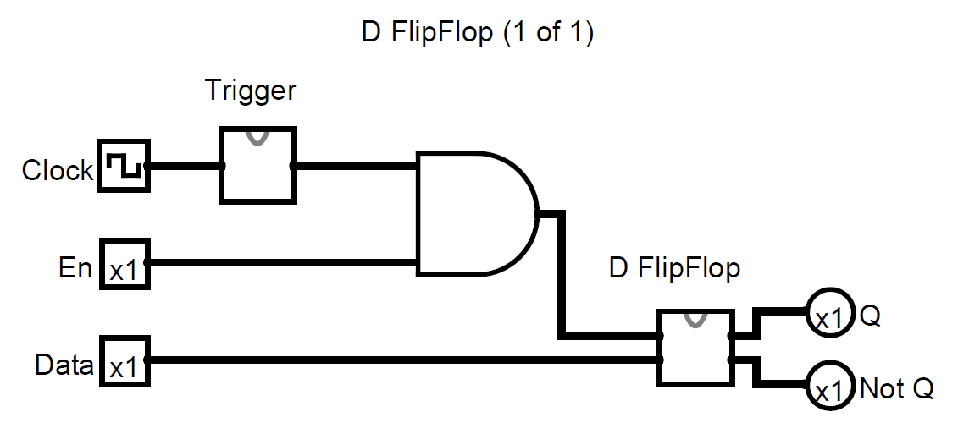
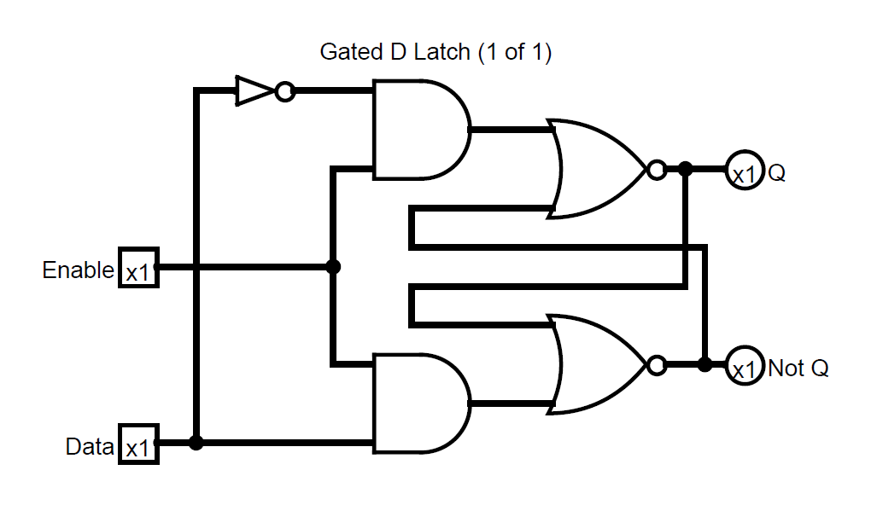
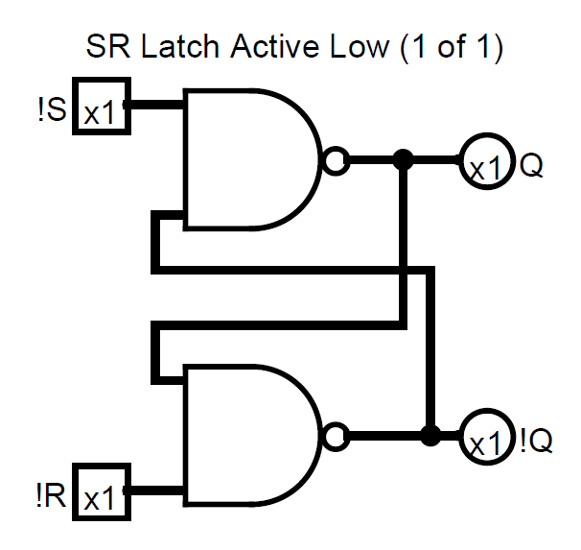
Ben Eater’s 8 Bit Computer
Latches and Memory
Notes:
Show 8-Bit Register LOGISIM File

Slide 34
Ben Eater’s 8 Bit Computer
Clock
Instruction Register
NOT Clock
Control Logic
Output
Control Logic

Slide 35
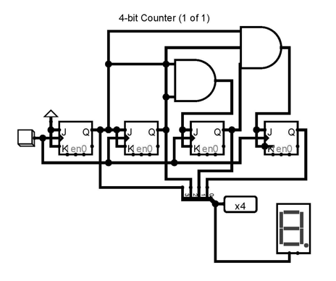
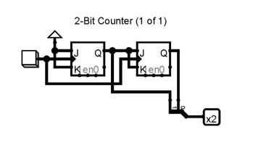
Ben Eater’s 8 Bit Computer
2 Bit Counter used in Instruction Step Counter
4 Bit Counter used in Program Counter
4 Bit Counter used in OUTPUT Display

Slide 36
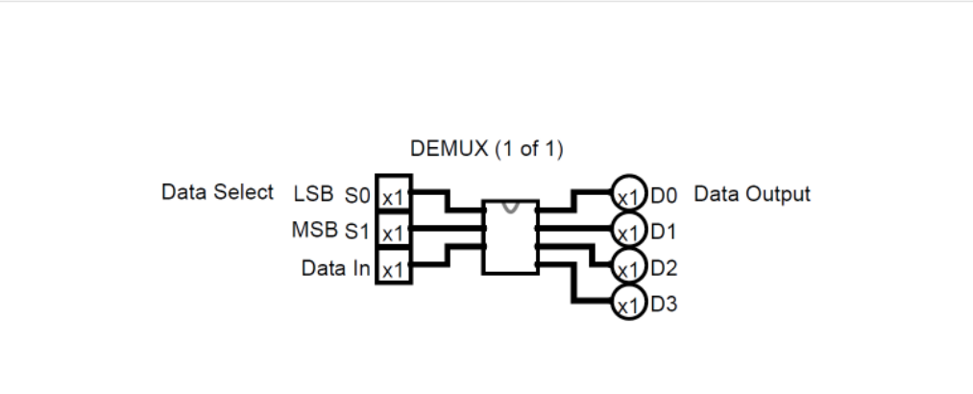
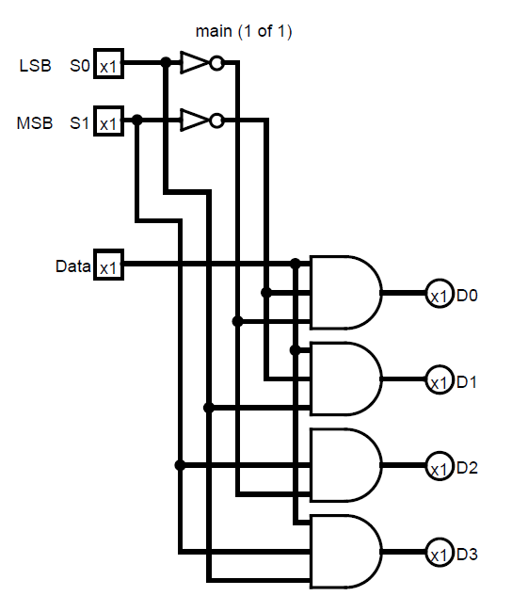
Ben Eater’s 8 Bit Computer

Slide 37
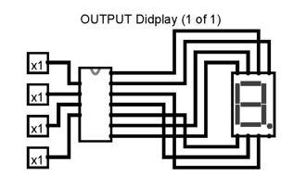
Ben Eater’s 8 Bit Computer
Figure from LOGISIM File.
Binary To Decimal to 7 Segment Conversion

Slide 38
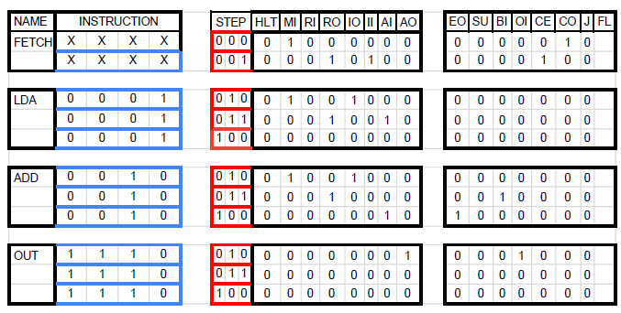
Ben Eater’s 8 Bit Computer
Instructions
Control Logic and Programing

Slide 39
CENTRAL PROCESSING UNIT(CPU)
RAM
DATA
ADDRESS
DATA
REGISTER A
REGISTER B
0000
00011110
00000000
00000000
0001
00101111
0010
11100000
0011
00000000
CONTROL
UNIT
INSTRUCTION REGISTER
0100
00000000
INPUT
INPUT
0000
0000
0101
00000000
ALU
(OP(CODE))
0110
00000000
OPERATION
CODE
ADDRESS INPUT
0111
00000000
00000000
1000
00000000
O
Z
N
INSTRUCTION REGISTER
counter
FLAG
1001
00000000
1010
00000000
OUTPUT
READ ENABLE
1011
00000000
CLOCK
1100
00000000
WRITE ENABLE
1101
00000000
1110
00011100
1111
00001110

Slide 40
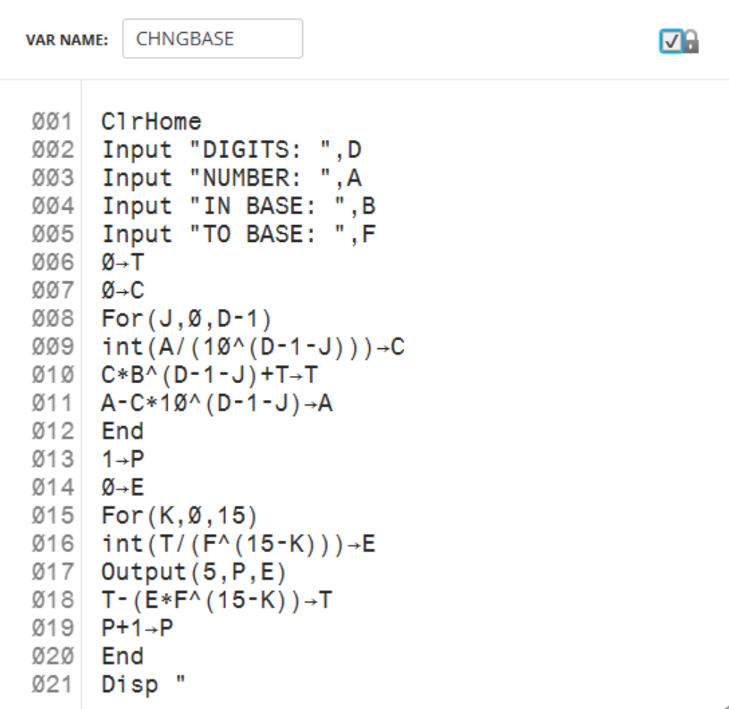
EXAMPLE OF ASM PROGRAM
On a TI-xxxx

Slide 41
Lesson Plans
ELTR-180
Networking and Data Communications
Project 1 build a 6502 to network with a partner:
https://eater.net/6502
Use the 6502 to do practical lessons with error correction:
https://eater.net/crc
Notes:
ELTR 180 – Networks and Data Communications
Course Overview
Course topics will include:
Basic definition of a network, brief history, and common uses
OSI & TCP/IP network models
Application Layer
Transport Layer
Internet Layer
Network infrastructure layer
Servers & clients
Network devices (Modems, routers, switches, cables, wireless access points)

Slide 42
Ben Eater’s 8 Bit Computer
Testing and TroubleShooting
Testing:
Run a Functional Module Check. You may Need to hookup the required INPUTS and OUTPUTS to see if the Module is operational.
Running the subsystem checks before networking them together or through the BUS will help isolate for troubleshooting.
ADD another module Test operations if good then add one more and Test. Do this until they Master System is completed.
TroubleShooting:
Problem
Clock has an inverter OUTPUT and only lights if the LED is place in circuit with Cathode to pin 8 of the 74LS08 AND Gate and Anode to VCC.
Solution
Maksure the ICs have VCC and Ground connected
Power distribution Problems
Why does an LED light when the INPUT is 0 v?
Solution
Trace signal on bus by remove each modules connection on by one until you find the one.
Sometimes damaged ICS will send random signals,
Vs

Slide 43
APA Citation
Eater, B. (n.d.). 8 Bit Computer. Eater.Net. https://eater.net/8bit
8 bit-computer.jpeg image
X,B.(n.d). Using the 555 Timer. DroneBot Workshop.https://dronebotworkshop.com/555-timer/
image of 555 timer schematic
Eater,B. [Ben Eater]. (Year, Month Day). Clock logic - 8-bit computer clock - part 4 [Video]. YouTube.
https://www.youtube.com/watch?v=SmQ5K7UQPMM
Anne,C. [ Crash Course]. (Year, Month Day). Crash Course- The Central Processing Unit (CPU) Crash Course Computer Science #7 [Video]. YouTube.
https://www.youtube.com/watch?v=FZGugFqdr60&t=548s
10:28 CPU SLIDE

Slide 44
Ben Eater 8 Bit Computer
GUIDE TO GETTING STARTED

Slide 45
Thank You

